Slide 1
Web security
Goodrich and Tamassia (Chapter 7)
(Prepared by Nafis Irtiza Tripto, Lecturer, CSE, BUET)

Slide 2
What could go wrong with our web app?
Our app could allow an attacker to view and/or modify any information or perform any operations we provide
Leak information provided
Perform actions on behalf of the user
Our app could be used to attack anything on our user's machine and or anything our user machine can talk to
If the user trusts us we can allow damage far beyond what the user gives to us
Security concept: Threat Model
What attacks are we trying to deal with?

Slide 3
Security is a hard problem
Many opportunities for attackers
Full stack means there are many interface that an attacker can use
Hard to identify all the vulnerabilities
Complexity of system make it impossible guarantee no vulnerabilities
Even a small mistake can compromise entire application
Only as strongest as the weakest link

Slide 4
Modes of attacks on web applications
Attack the connection between browser and web server
Steal password
Hijack existing connection
Attack the server
Inject code that does bad things
Attack the browser
Inject code that does bad things
Breach the browser, attack the client machine
Fool the user (phishing)

Slide 5
Background knowledge

Slide 6
http and Html

Slide 7
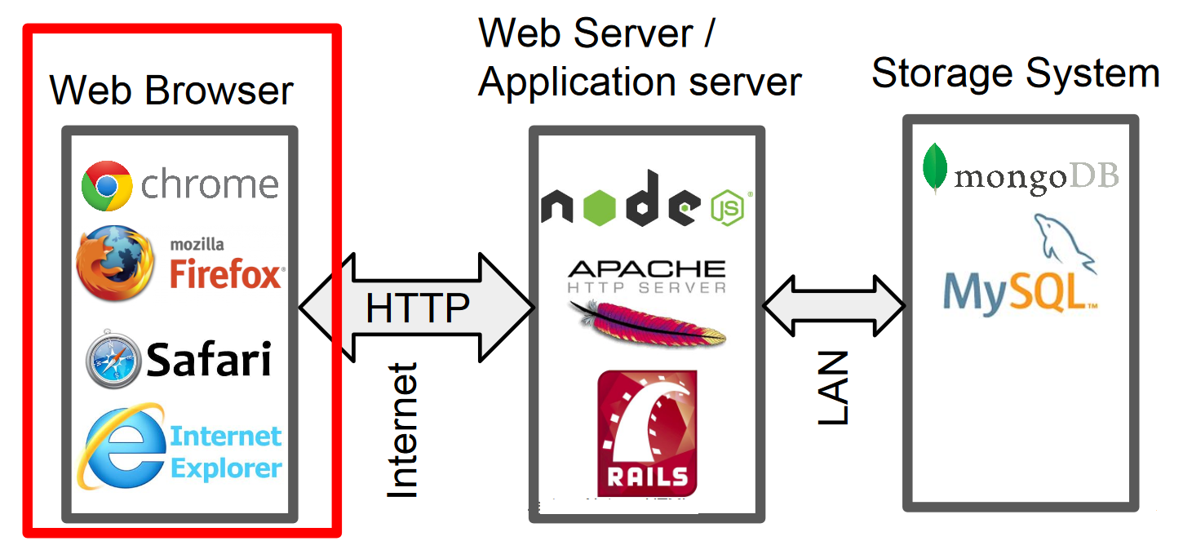
Web application architecture

Slide 8
Uniform Resource Locators (URLs)
The process of visiting a website begins with the browser determining the IP address of the web server that is hosting
A web browser identifies a web site with a uniform resource locator, or URL.
Here, www.example.com is the domain of the web server holding the web site of interest, directory is the name of the folder that is storing the web site of interest, and file.html is a file that describes the text and images for a page on this web site
http://www.example.com/directory/file.html

Slide 9
Connecting to a Web Server
Given such a URL, the web browser first checks the local DNS cache on its system for an entry corresponding to the domain of the web site being requested.
If no entry is found locally, the browser queries a DNS server to resolve the IP address of the domain name.
After the IP address of the web server is resolved, the client makes a TCP connection to a specified port on the web server, which is, by default, port 80 for HTTP.
Other protocols besides HTTP could also be used in a URL
Port: 21 File Transfer Protocol (FTP) Port: 80 Hypertext Transfer Protocol (HTTP) Port: 443 Hypertext Transfer Protocol over TLS/SSL (HTTPS)

Slide 10
HTTP Request
After establishing a TCP connection to the web server, the browser sends requests, known as HTTP requests, to that web server, encapsulated in the data portion of a TCP packet.
HTTP requests typically begin with a request line, usually consisting of a command such as GET or POST.
Next is the headers section that identifies additional information.
Finally, there may be more information provided in an optional message body.

Slide 11
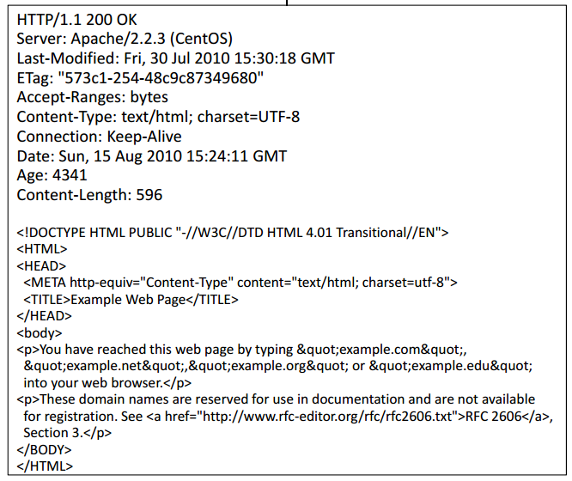
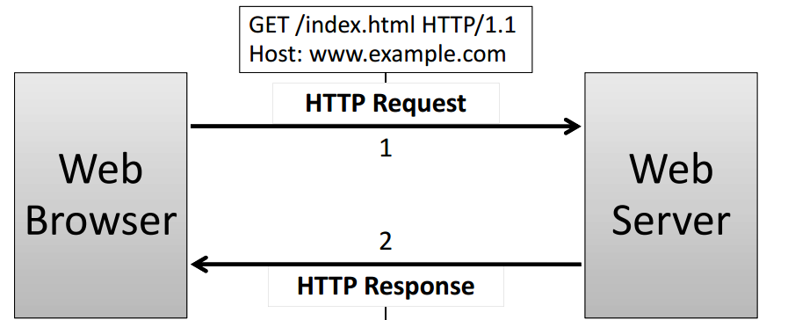
HTTP Request

Slide 12
Hypertext Markup Language (HTML)
Hypertext markup language (HTML)
–Describes the content and formatting of Web pages
–Rendered within browser window
HTML features
–Static document description language
–Supports linking to other pages and embedding images by reference
–User input sent to server via forms
HTML extensions
–Additional media content (e.g., PDF, video) supported through plugins
–Embedding programs in supported languages (e.g., JavaScript, Java) provides dynamic content that interacts with the user, modifies the browser user interface, and can access the client computer environment

Slide 13
HTML Tag
• Text formatting: such as <i>text</i>, for italics and <b>text</b>, for bold
• Itemized lists: which list items set apart with bullets or numbers, such as <ul> <li>first-item</li> <li>second-item</li> </ul>
• Hyperlinks: which provide ways to navigate to other web pages, such as in <a href="web-page-URL"> Description of the other page</a>
• Scripting code: which describes various actions for the web page, such as in <script>Computer code</script>
• Embedded images: such as in <img src="URL-of-an-image">

Slide 14
HTML Form
<form action="/product/update" method="post">
Product: <input type="text" name="product"/><br />
Deluxe: <input type="checkbox" name="delux" /><br />
<input type="submit" value="Submit"/>
</form>
method="get" - Encode form properties as query params
HTTP GET product/update?product=foobar&delux=on
method="post" - Encode form properties as query params in message body
HTTP POST product/update
Content-Type: application/x-www-form-urlencoded
product=foobar&delux=on
Notes:
GET variables are recommended for operations such as querying a database, that do not have any permanent results. If the processing of the form has side effects, such as inserting a record in a database or sending an email, POST should be used.

Slide 15
More on get and post
POST requests cannot be bookmarked
GET
POST
GET requests can be cached
GET requests remain in the browser history
GET requests can be bookmarked
GET requests should never be used when dealing with sensitive data
GET requests have length restrictions
GET requests is only used to request data (not modify)
POST requests are never cached
POST requests do not remain in the browser history
POST requests can not be bookmarked
POST request have no restriction on data length
Notes:
GET' is limited to 2048 characters.

Slide 16
Lack of Confidentiality in HTTP
By default, HTTP requests and responses are delivered via TCP over port 80.
The standard HTTP protocol does not provide any means of encrypting its data.
Because of this lack of encryption, if an attacker could intercept the packets being sent between a web site and a wen browser, he would gain full access to any information the user was transmitting, and could also modify it, as in a man-in-the-middle scenario.

Slide 17
HTTPS and Certificate

Slide 18
Network Attacks
"man in the middle" attacks
Attacker has access to network communication between browser and server.
Passive attacks:
Eavesdrop on network traffic
Active attacks:
Inject network packets
Modify packets
Reorder, replay packets
Block packets

Slide 19
Cryptography to the rescue
Solution: use encryption to prevent eavesdropping and detect active attacks.
Old idea: Scramble the information before transmitting it, unscramble when received
Traditional encryption:
Symmetric keys (same key on both ends)
Key distribution problem: how can we exchange keys without meeting in person?
Public-key encryption helps with the key distribution problem
Each principal (user, program, etc.) has two encryption keys, one public, one secret
Information encrypted with one can only be decrypted with the other.
Encrypt with public key: Only principle can access
Encrypt with secret key: Know that it comes from principle
Public-key encryption is slower than symmetric encryption
Use public-key to exchange symmetric key

Slide 20
HTTPS
To solve the confidentiality problem inherent in HTTP, an alternative protocol is available called HTTPS (hypertext transfer protocol over secure socket layer).
Incorporates an additional layer of security known as SSL (secure socket layer), or a newer implementation, known as TLS (transport layer security).
SSL and TLS rely on the notion of a certificate to verify the identity of the server and establish an encrypted communication channel between the web browser and the web server.
Only one way: SSL/TLS does not allow the server to verify browser identity

Slide 21
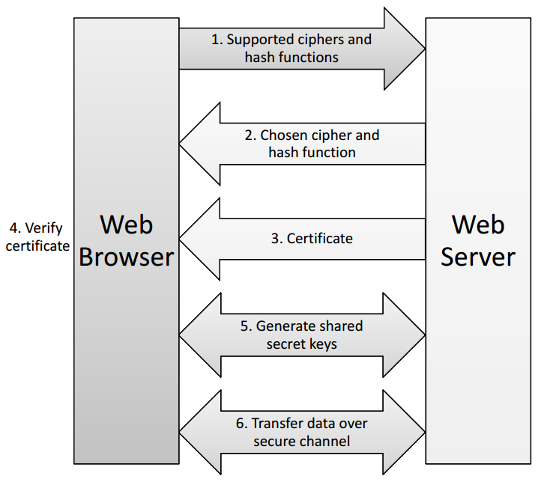
Establishing a HTTPS session
Notes:
This approach protects the confidentiality (via the symmetric cryptosystem) and integrity (via the MAC) of the HTTP requests and responses.

Slide 22
Web Server certificate
Certificate authority: well-known, trusted server that certifies public keys.
Certificate: a document encrypted with the secret key of a certificate authority
Identifies a particular service along with its public key
Service can pass along this certificate to browsers
Browser can validate the certificate came from the certification authority and see who the certification authority thinks the browser is talking to.
Trust: Browser trusts to certification authority

Slide 23
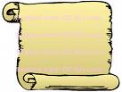
Certificates
How does Alice (browser) obtain PK_{Bob} ?
Browser Alice
CA
Server Bob
choose
(SK,PK)
PK and
proof “I am Bob”
check
proof
PK_{CA}
PK_{CA}
SK_{CA}
issue Cert with SK_{CA} :
Verify
cert
Bob’s key is PK
Bob’s key is PK
Bob uses Cert for an extended period (e.g. one year)

Slide 24
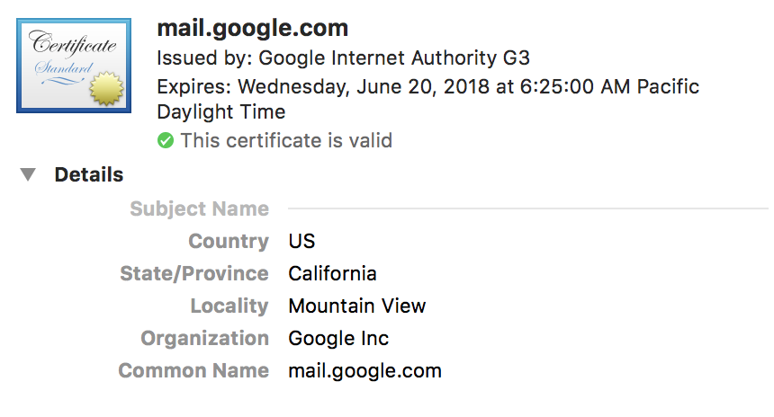
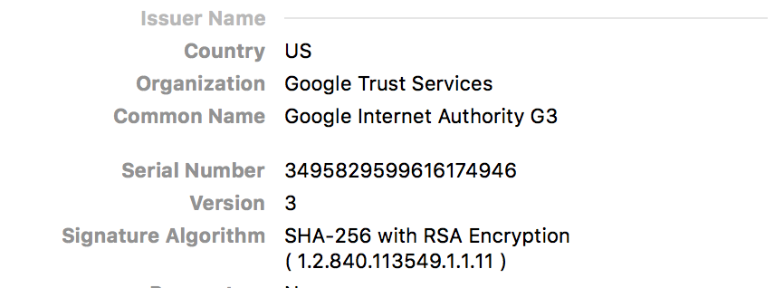
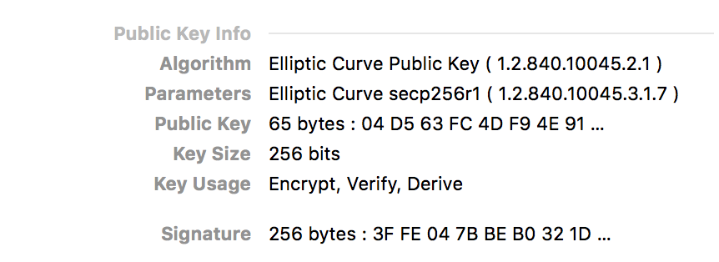
Sample certificate

Slide 25
Why not using HTTPS for all Web traffic?
Expensive: slows down web servers
more cycles per connection
Can now offload to networking hardware
Breaks in-the-middle web page caching
Some ad-networks still do not support HTTPS
reduced revenue for publishers
Incompatible with virtual hosting (older browsers)
However today around 75% of most popular websites use HTTPS
Percentage going up quickly
Chrome will mark HTTP sites as insecure

Slide 26
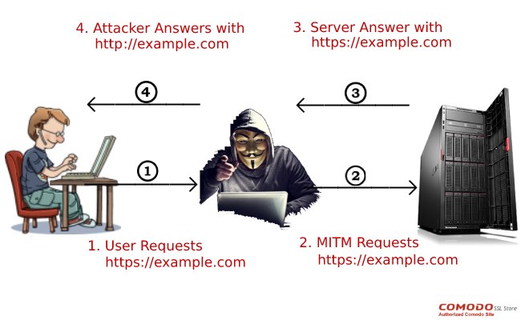
Problem: SSL stripping
Common use pattern:
user browses site with HTTP, upgrades to HTTPS for checkout.
connect to bank over HTTP; move to HTTPS for login
When server returns pages with HTTPS links, attacker changes them to HTTP
Notes:
●Common use pattern: user browses site with HTTP, upgrades to HTTPS for checkout.●Active network attacker interposes on communication●When server returns pages with HTTPS links, attacker changes them to HTTP.●When browser follows those links, attacker intercepts requests, creates its own HTTPS connection to server, and forwards requests via that.●As a result, the attacker sees all client packets (e.g., passwords).●Browser provides feedback to user about whether HTTPS is in use, but most users won't notice the difference

Slide 27
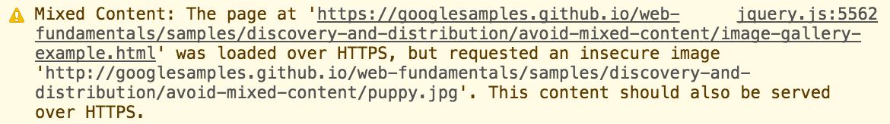
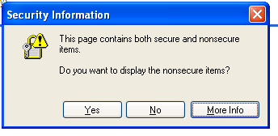
Problem: Mixed content
Main page loaded with HTTPS, but some internal content loaded via HTTP
Some browsers help to notify users
Notes:
Although many browsers report mixed content warnings to the user, by the time this happens, it is too late: the insecure requests have already been performed and the security of the page is compromised. This scenario is, unfortunately, quite common on the web, which is why browsers can't just block all mixed requests without restricting the functionality of many sites.

Slide 28
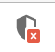
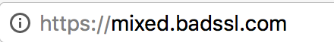
Problem: Mixed content
Mixed script: <script src="http://mixed-script.badssl.com/nonsecure.js"></script>
Mixed image: <img class="mixed" src=http://mixed.badssl.com/image.jpg”>
(script is blocked, click to load)
Image loaded, but no HTTPS indicator
Notes:
Common developer error:
over-specified URLs:
<script src="http://www.site.com/library.js">
Instead, don't specify explicit protocols (or even site):
<script src="/library.js">

Slide 29
Problem: Bad certificate
If a certificate is bad/unknown, browser issues warning dialog:
Most users can't understand, so they just click OK.
Some browsers warn repeatedly, but users will still just click through.
This enables various network attacks.

Slide 30
Man in the middle attack using rogue cert
GET https://bank.com
BadguyCert
BankCert
ClientHello
attacker
ClientHello
bank
ServerCert (rogue)
ServerCert (Bank)
(cert for Bank by a valid CA)
SSL key exchange
SSL key exchange
k₁
k₁
k₂
k₂
HTTP data enc with k₁
HTTP data enc with k₂
Attacker proxies data between user and bank. Sees all traffic and can modify data at will.

Slide 31
Document object model

Slide 32
Javascript interface to HTML document
HTML document exposed as a collection of JavaScript objects and methods The Document Object Model (DOM)
The DOM framework takes an object-oriented approach to HTML code, conceptualizing tags and page elements as objects in parent-child relationships, which form a hierarchy called the DOM tree
JavaScript can query or modify the HTML document
Rooted at window.document
To indicate to a browser that Javascript is being used, the <script> and </script> tags are used to separate sections of Javascript from ordinary HTML code

Slide 33
Sample example
<script type="text/javascript"> function hello() { alert("Hello world!"); } </script>
<img src="picture.gif" onMouseOver="javascript:hello()">
Common DOM Operations:
Change the content of an element
Change an <img tag src attribute (e.g. toggle appearance on click)
Make element visible or invisible (e.g., for expandable sections, modals)
Redirect to a new page
Communicate with a user

Slide 34
Session and cookie

Slide 35
Why use sessions or cookies?
It is often useful for web sites to keep track of the behavior and properties of its users.
The HTTP protocol is stateless
Session encapsulates information about a visitor that persists beyond the loading of a single page
several approaches for web servers to maintain session information for their users
Passing session information via GET or POST
Maintaining cookies
Implementing Server-side sessions management

Slide 36
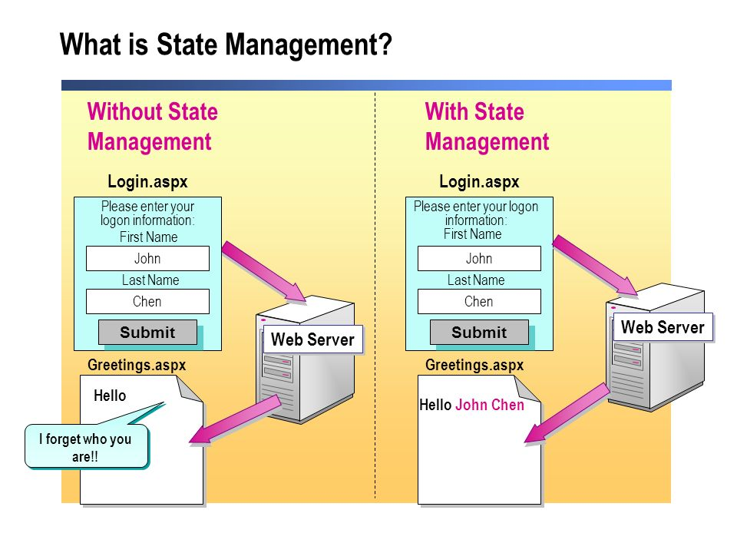
Why use sessions or cookies?

Slide 37
Sessions
A sequence of requests and responses from one browser to one (or more) sites
the server generates a small segment of invisible code capturing the user’s session information and inserts it into the page being delivered to the client using the mechanism of hidden fields.
Each time the user navigates to a new page, this code passes the user’s session information to the server allowing it to “remember” the user’s state.

Slide 38
Session tokens
Browser
web site
GET /index.html
set anonymous session token
GET /books.html
anonymous session token
check credentials
(crypto)
POST /do-login
Username & password
elevate to a logged-in session token
POST /checkout
logged-in session token
Validate
token
Notes:
Validate token: check that it belongs to an active session that has not been logged out or timed out.

Slide 39
Session Token problem
particularly susceptible to man-in-the-middle attacks, unfortunately, since HTTP requests are unencrypted.
An attacker gaining access to the GET or POST variables being submitted by a user could hijack their session and assume their identity.
HTTPS must be used in conjunction with sessions implemented with GET or POST variables to protect the user from these attacks.

Slide 40
Cookies
uses small packets of data, called cookies, which are sent to the client by the web server and stored on the client’s machine
POST …
Server
Browser
HTTP Header:
Set-cookie: NAME=VALUE ;
domain = (who can read) ;
expires = (when expires) ;
secure = (only over SSL)
If expires=NULL:
this session only
Server
Browser
POST …
Cookie: NAME = VALUE
HTTP is stateless protocol; cookies add state

Slide 41
Cookie authentication
Browser
Web Server
Auth server
POST login.cgi
Username & pwd
Validate user
Set-cookie: auth=val
auth=val
Store val
GET restricted.html
Cookie: auth=val
restricted.html
auth=val
Check val
If YES, restricted.html
YES/NO

Slide 42
Setting/deleting cookies by server
GET …
Server
Browser
HTTP Header:
Set-cookie: NAME=VALUE ;
domain = (when to send) ;
path = (where to send)
secure = (only send over SSL);
expires = (when expires) ;
HttpOnly
SameSite = [lax | strict]
scope
weak XSS defense
Default scope is domain and path of setting URL
weak CSRF defense
Notes:
SameSite cockies: e.g. do not send cookie on a cross-site POST request (strict means never send cookie on cross-site request).
http://www.sjoerdlangkemper.nl/2016/04/14/preventing-csrf-with-samesite-cookie-attribute/
Supported in Chrome 51.

Slide 43
Cookie Expiry
If no expiration date is specified, the cookie defaults to being deleted when the user exits the browser
if expires=NULL:
this session only
if expires=past date:
browser deletes cookie

Slide 44
Cookie Scope
A subdomain can set a cookie for a higher-level domain, but not vice versa. subdomains can access cookies set for the top-level domain, but not the other way around.
Hosts can access cookies set for their top-level domains, but hosts can only set cookies for domains one level up in the domain hierarchy
one.mail.example.com could read (but not set) a cookie for .example.com
there are rules to prevent web sites from setting cookies for top-level domains such as .edu or .com
disallowed domains
other.site.com
othersite.com
.com
allowed domains
login.site.com
.site.com

Slide 45
Secure Cookies
GET …
Server
Browser
HTTP Header:
Set-cookie: NAME=VALUE ;
Secure=true
Provides confidentiality against network attacker
Browser will only send cookie back over HTTPS
… but no integrity
Can rewrite secure cookies over HTTP
network attacker can rewrite secure cookies
can log user into attacker’s account
Notes:
HttpOnly in IE can be written to by script, but cannot be read

Slide 46
httpOnly Cookies
GET …
Server
Browser
HTTP Header:
Set-cookie: NAME=VALUE ;
httpOnly
Cookie sent over HTTP(s), but not accessible to scripts
cannot be read via document.cookie
Helps prevent cookie theft via XSS
… but does not stop most other risks of XSS bugs
Notes:
HttpOnly in IE can be written to by script, but cannot be read

Slide 47
Examples
both set by login.site.com
cookie 1
name = userid
value = u1
domain = login.site.com
path = /
secure
cookie 2
name = userid
value = u2
domain = .site.com
path = /
non-secure
http://checkout.site.com/
http://login.site.com/
https://login.site.com/
cookie: userid=u2
cookie: userid=u2
cookie: userid=u1; userid=u2
Notes:
FF3: most specific cookie sent first

Slide 48
Client side read/write: document.cookie
Setting a cookie in Javascript:
document.cookie = “name=value; expires=…; ”
Reading a cookie: alert(document.cookie)
prints string containing all cookies available for document (based on [protocol], domain, path)
Deleting a cookie:
document.cookie = “name=; expires= Thu, 01-Jan-70”
HttpOnly cookies: not included in document.cookie
Notes:
SOP: same as server-side read/write.

Slide 49
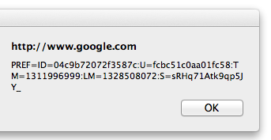
Javascript URL
javascript: alert(document.cookie)
Displays all cookies for current document

Slide 50
Cookie protocol problems
Server is blind:
Does not see cookie attributes (e.g. secure, HttpOnly)
Does not see which domain set the cookie
Server only sees: Cookie: NAME=VALUE
Notes:
RFC 2109 (cookie RFC) has an option for including domain, path in Cookie header, but not supported by browsers.

Slide 51
Example 1: login server problems
Alice logs in at login.site.com
login.site.com sets session-id cookie for .site.com
2. Alice visits evil.site.com
overwrites .site.com session-id cookie with session-id of user “badguy”
3. Alice visits course.site.com to submit homework
course.site.com thinks it is talking to “badguy”
Problem: course.site.com expects session-id from login.site.com;
cannot tell that session-id cookie was overwritten
Notes:
Writes creditcard number into attacker’s account. Common in hosting providers.

Slide 52
Example 2: “secure” cookies are not secure
Alice logs in at https://accounts.google.com
Alice visits http://www.google.com (cleartext)
Network attacker can inject into response
Set-Cookie: SSID=badguy; secure
and overwrite secure cookie
Problem: network attacker can re-write HTTPS cookies !
HTTPS cookie value cannot be trusted
set-cookie: SSID=A7_ESAgDpKYk5TGnf; Domain=.google.com; Path=/ ; Expires=Wed, 09-Mar-2026 18:35:11 GMT; Secure; HttpOnly
set-cookie: SAPISID=wj1gYKLFy-RmWybP/ANtKMtPIHNambvdI4; Domain=.google.com;Path=/ ; Expires=Wed, 09-Mar-2026 18:35:11 GMT; Secure
Notes:
Alice visits http://www.google.com automatically due to phishing filter

Slide 53
Cookies have no integrity
User can change and delete cookie values
Edit cookie database (FF: cookies.sqlite)
Modify Cookie header (FF: TamperData extension)
Silly example: shopping cart software
Set-cookie: shopping-cart-total = 150 ($)
User edits cookie file (cookie poisoning):
Cookie: shopping-cart-total = 15 ($)
Similar problem with hidden fields
<INPUT TYPE=“hidden” NAME=price VALUE=“150”>
53
Notes:
53

Slide 54
Solution: cryptographic checksums
Goal: data integrity
Requires server-side secret key k unknown to browser
Generate tag: T ⟵ MACsign(k, SID ll name ll value )
Server
Browser
Set-Cookie: NAME =
k
value
T
Cookie: NAME =
value
T
Verify tag: MACverify(k, SID ll name ll value, T)
Binding to session-id (SID) makes it harder to replay old cookies
Notes:
non-keyed checksums (e.g. CRC) are insufficient for this purpose !!
Can still swap with cookies from another active session. Bind to IP address?

Slide 55
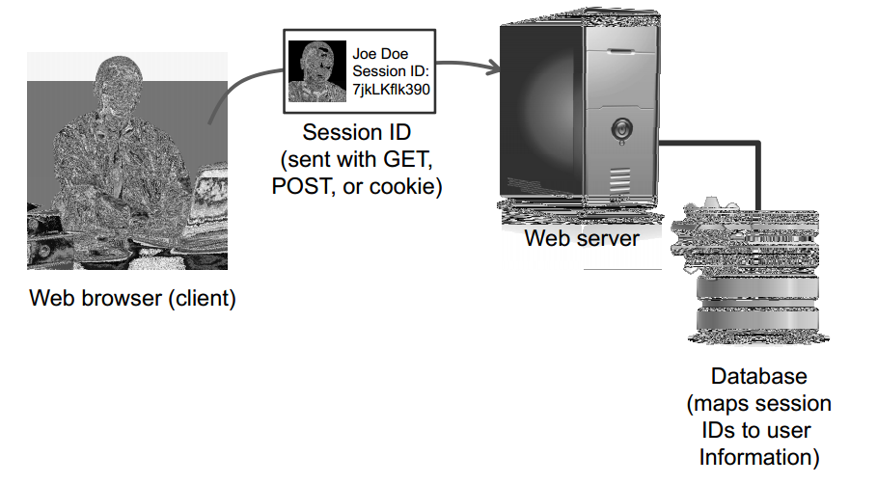
Server side sessions
Servers typically use a session ID or session token — a unique identifier that corresponds to a user’s session.
The server then employs one of the two previous methods (GET/POST variables or cookies) to store this token on the client side.
if the client’s computer is ever compromised, then all the attacker learns is an old session ID that is likely to have expired by the time the attack occurs.

Slide 56
Client side attacks

Slide 57
Attacks on Web browser
As Web browser is an integral part of the way people use computers, they are the popular targets for attacks
Different kinds of attacks:
Session hijacking
Phishing
URL obfuscation
Privacy attacks
Cross Site Scripting (XSS)
Cross Site Request Forgery (CSRF)

Slide 58
Session hijacking

Slide 59
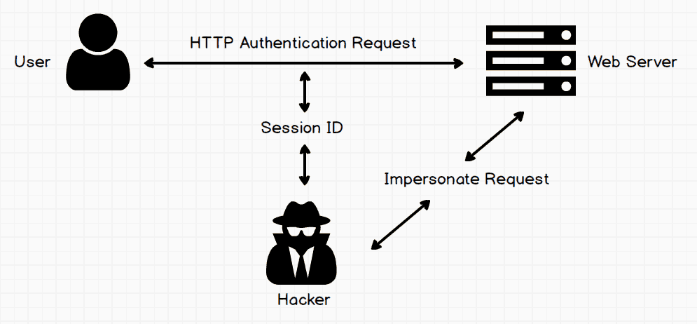
Session Hijacking

Slide 60
Session Hijacking
Attacker waits for user to login
then attacker steals user’s Session Token and “hijacks” session
⇒ attacker can issue arbitrary requests on behalf of user
Example: FireSheep [2010]
Firefox extension that hijacks Facebook session tokens over WiFi. Solution: HTTPS after login

Slide 61
Predictable Tokens
Example 1: counter
⇒ user logs in, gets counter value, can view sessions of other users
Example 2: weak MAC. token = { userid, MAC_{k}(userid) }
Weak MAC exposes k from few cookies.
Session tokens must be unpredictable to attacker
To generate: use underlying framework (e.g. ASP, Tomcat, Rails)
Rails: token = MD5( current time, random nonce )
Notes:
Thus, to prevent session hijacking when sessions are established using client-side tokens, it is important for servers to encrypt such session tokens. Likewise, server-side session IDs should be created in ways that are difficult to predict, for instance, by using pseudo-random numbers.

Slide 62
Need to use HTTPS to protect cookies
Even if session id chosen carefully, network attackers can read cookies from unencrypted connections
Sessions not using HTTPS inherently vulnerable to network attacks.
HTTP/HTTPS upgrade problem:
Suppose session starts out with HTTP, converts to HTTPS after login
Network attacker could have read session id during HTTP portion of session
Once logging is complete, attacker can use the id to hijack the logged in session
Change the session id after any change in privilege or security level

Slide 63
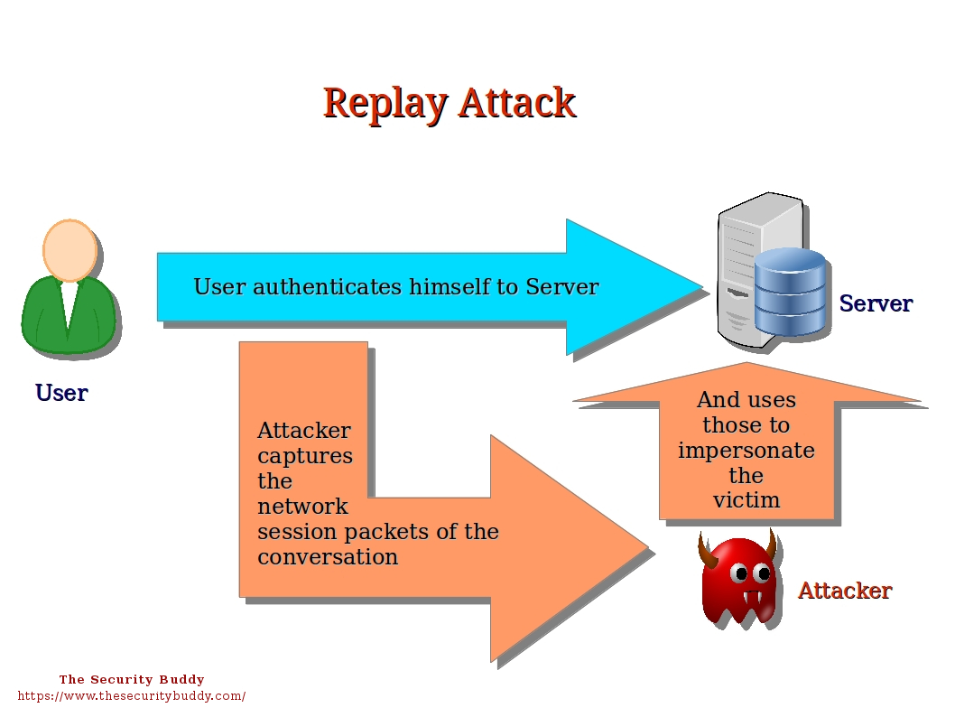
Replay Attack
Attacks based on reusing old credentials to perform false authentications or authorizations.
a replay attack would involve an attacker using an old, previously valid token to perform an attempted HTTP session hijacking attack.

Slide 64
How to prevent Replay Attack
incorporating random numbers into client-side tokens, as well as server-side tokens, and also by changing session tokens frequently, so that tokens expire at a reasonable rate
Associate a session token with the IP addresses of the client so that a session token is considered valid only when connecting from the same IP address.
One time password is also another approach to prevent replay attack
Sending Timestamp frequently is also another approach

Slide 65
Phishing

Slide 66

Phishing
Basic idea:
Get unsuspecting users to visit an evil Web site
Convince them that the evil Web site is actually a legitimate site (such as a bank or PayPal)
Trick the user into disclosing personal information (password, credit card number, etc.)
Use the personal information for evil purposes such as identity theft.
hides its activity from the user, either by redirecting them to the real site or presenting a notice that the site is “down for maintenance.”
How to attract users?
Notes:
https://www.xplace.com/article/3447

Slide 67
How to attract users?
Spam email
Sponsored advertisements on other sites
Ads relatively cheap
Ad networks, publishers incentivized to show ads, minimize background checks
Network attacks: redirect legitimate traffic
Infected machine:

Slide 68
Spoofing legitimate sites
How to spoof the legitimate site?
Copy HTML
Include images from legitimate Web site
Many links refer back to the legitimate Web site
After collecting login info, log user into legitimate site, redirect to legitimate site
User has no idea that password has been stolen

Slide 69
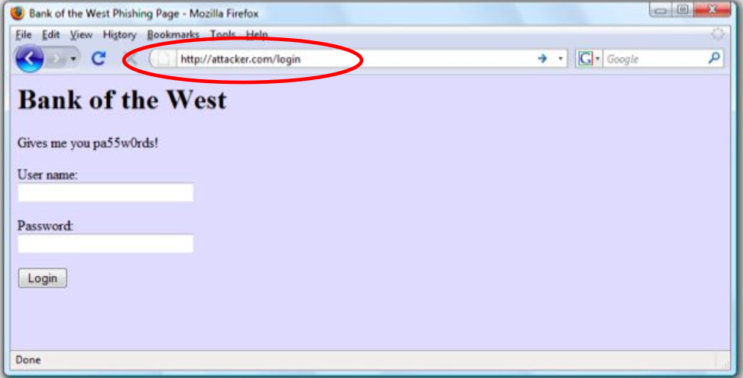
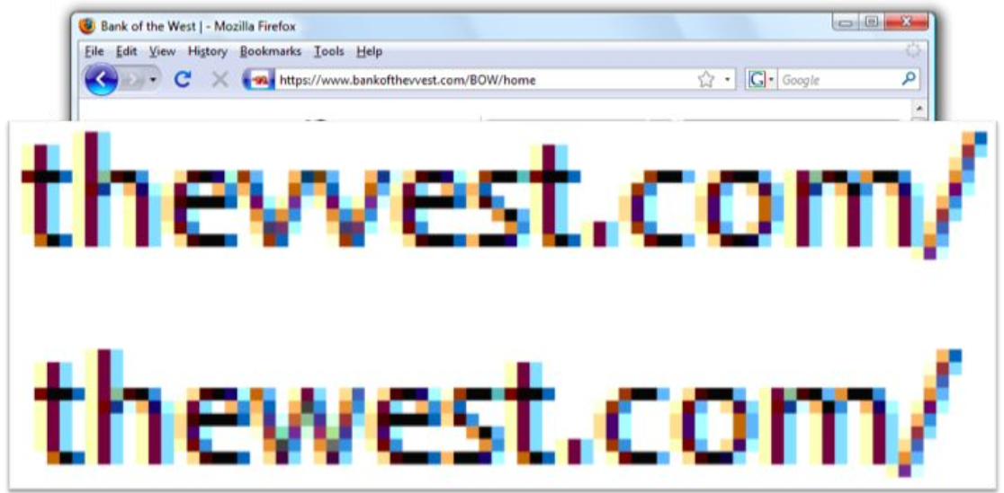
Won't user recognize a bogus address in the URL bar?
URL could be obviously Illegitimate
Or very subtly different: Look-alike characters

Slide 70
Won't user recognize a bogus address in the URL bar?
Many people won't notice the difference.
Attacker can pick names that look similar to legitimate names:
"vv" instead of "w"
bankofthewest.login.com
Companies often use multiple names themselves (e.g., partners) so it's hard to tell what is legitimate.

Slide 71
International Character Sets
What does this URL refer to:
Chinese characters that look like "/", "?", and "="
This is a host name only!
www.paypal.com using the Cyrillic letter p, which has Unicode value #0440, instead of the ASCII letter p, which has Unicode value #0070.
www.bank.com/accounts/login.php?q=me.badguy.cn
Notes:
This attack could be prevented by disabling international characters in the address bar, but this would prevent navigation to sites with international characters in their domain names.

Slide 72
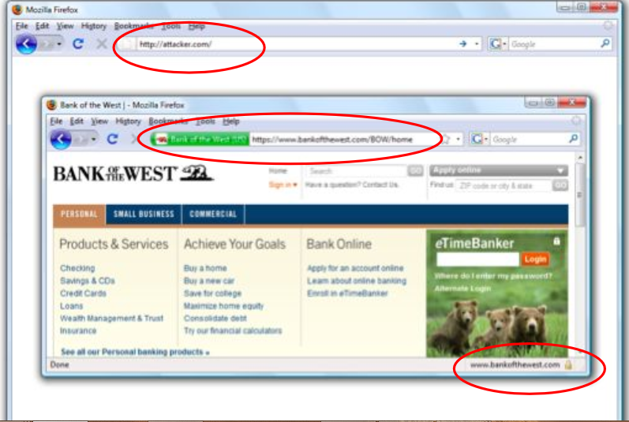
Picture in picture
Use image to generate fake browser look-alike inside the main window

Slide 73
Counter-measure: visual indicators
Help users identify legitimate sites:
Lock symbols to indicate HTTPS
Color change to indicate HTTPS
Problems:
Lock symbols not always obvious

Slide 74
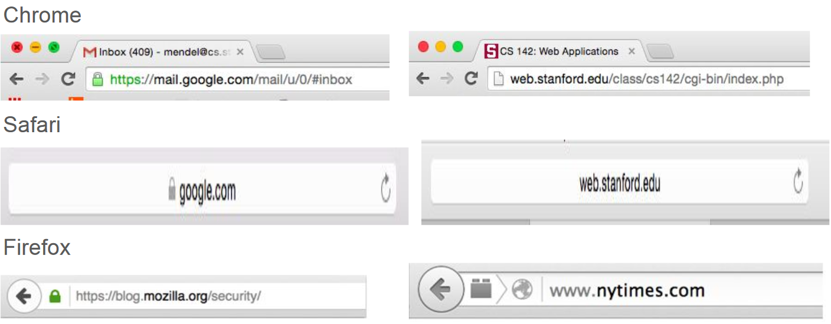
HTTPS Indicators

Slide 75
Problem: too easy to obtain certificates
Problem: too easy to obtain certificates that look like legitimate sites
Example: bankofamerica-secure.com
Pressure on certificate authorities to issue certificates quickly
E.g. "domain validation only" certificates: certificate authority only verifies that applicant has right to a particular Internet domain name; no verification of legal status of organization.

Slide 76
Counter-measure: extended validation certificates
Goal: prevent attackers from obtaining certificates that look like legitimate sites
Certificate authority must thoroughly vet the organization obtaining the certificate; prevent look-alike names.
Certificate authority must undergo audits to ensure it is doing the vets carefully.
Browser provides special indicator for extended validation sites
Problems:
Small organizations don't like delays and cost of extended validation
Until recently, extended validation indicators not very visible in browsers (but much better nowadays

Slide 77
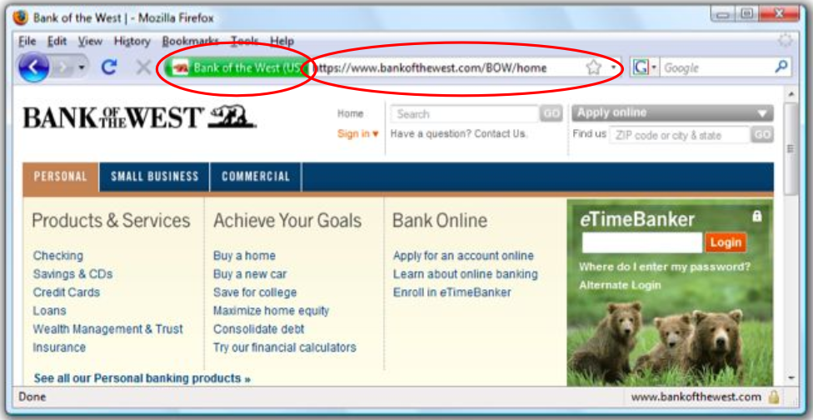
Extended Validation Certificates

Slide 78
Other counter-measures
Browsers starting to include anti-phishing measures (warn users about known phishing sites)
Legitimate Web sites can monitor traffic; changes may indicate attacks under way:
Spike in download rates for official images
Unusual rate of password changes, funds transfers
Legitimate sites can incorporate personal information in emails to authenticate them: phishers won't have such information.
Spear phishing - Phishing with attacker having personal information

Slide 79
Click-jacking

Slide 80
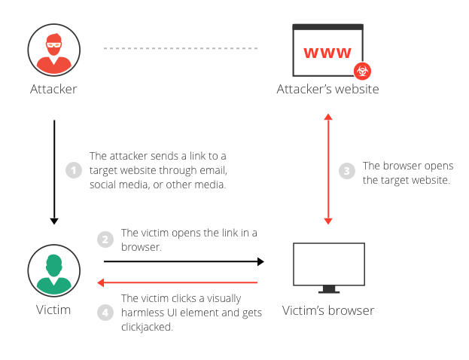
Click Jacking

Slide 81
Click Jacking
click-jacking is a form of web site exploitation where a user’s mouse click on a page is used in a way that was not intended by the user.
it is possible for malicious sites to use other Javascript event handlers such as onMouseOver
<a onMouseUp=window.open("http://www.evilsite.com") href="http://www.trustedsite.com/">Trust me!</a>

Slide 82
Click Fraud
click-jacking might be used is advertisement fraud
Clickjacking can be used to force users to unwillingly click on advertisements, raising the fraudulent site’s revenue
NoScript plugin for Firefox allows users to maintain a whitelist of trusted host names for which scripts are allowed execution.

Slide 83
Cross site request forgery (CSRF)

Slide 84
OWASP Top Ten (2013/17)
A-1 | Injection | Untrusted data is sent to an interpreter as part of a command or query.
A-2 | Authentication and Session Management | Attacks passwords, keys, or session tokens, or exploit other implementation flaws to assume other users’ identities.
A-3 | Cross-site scripting | An application takes untrusted data and sends it to a web browser without proper validation or escaping
… | Various implementation problems | …expose a file, directory, or database key without access control check, …misconfiguration, …missing function-level access control
A-8 | Cross-site request forgery | A logged-on victim’s browser sends a forged HTTP request, including the victim’s session cookie and other authentication information
https://www.owasp.org/index.php/Top_10_2013-Top_10

Slide 85
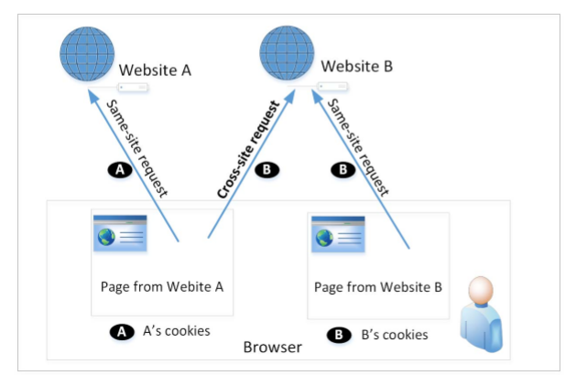
Cross-Site Requests
When a page from a website sends an HTTP request back to the website, it is called same-site request.
If a request is sent to a different website, it is called cross-site request because the where the page comes from and where the request goes are different.
Eg : A webpage (not Facebook) can include a Facebook link, so when users click on the link, HTTP request is sent to Facebook.

Slide 86
Cross-Site Requests and Its Problems
When a request is sent to example.com from a page coming from example.com, the browser attaches all the cookies belonging to example.com.
Now, when a request is sent to example.com from another site (different from example.com), the browser will attach the cookies too.
Because of above behaviour of the browsers, the server cannot distinguish between the same-site and cross-site requests
It is possible for third-party websites to forge requests that are exactly the same as the same-site requests.
This is called Cross-Site Request Forgery (CSRF).

Slide 87
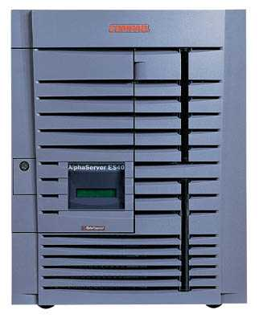
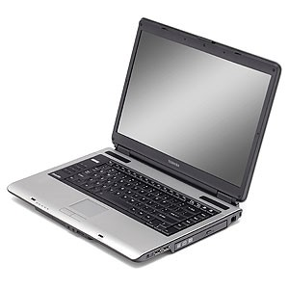
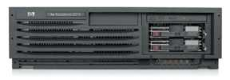
Basic CSRF
Server Victim
establish session
1
send forged request
4
(w/ cookie)
2
User Victim
3
visit server (or iframe)
receive malicious page
Attack Server
Q: how long do you stay logged in to Gmail? Facebook? ….

Slide 88
Cross Site Request Forgery (CSRF)
Example:
User logs in to bank.com
Session cookie remains in browser state
User visits another site containing:
<form name=F action=http://bank.com/BillPay.php>
<input name=recipient value=badguy> …
<script> document.F.submit(); </script>
Browser sends user auth cookie with request
Transaction will be fulfilled
Problem:
cookie auth is insufficient when side effects occur

Slide 89
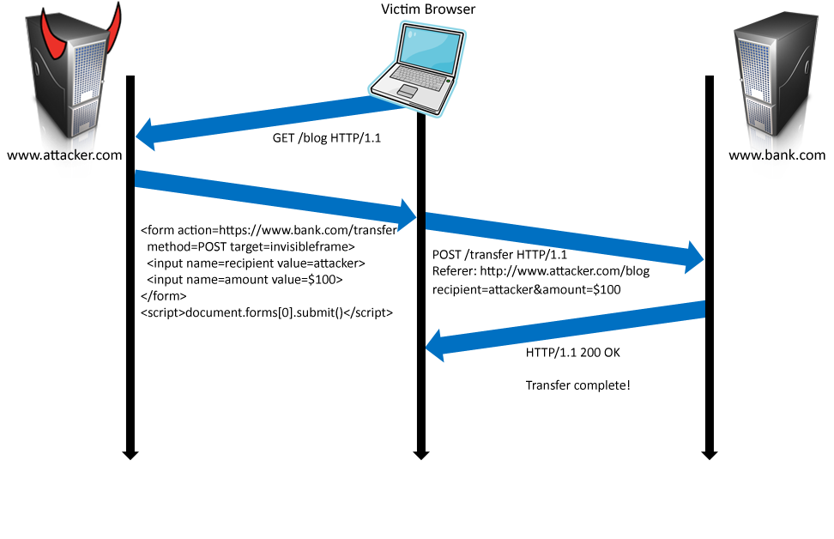
Form post with cookie
Cookie: SessionID=523FA4cd2E
User credentials

Slide 90
CSRF Attack on GET Requests - Basic Idea
Consider an online banking web application www.bank32.com which allows users to transfer money from their accounts to other people’s accounts.
An user is logged in into the web application and has a session cookie which uniquely identifies the authenticated user.
HTTP request to transfer $500 from his/her account to account 3220:
http://www.bank32.com/transfer.php?to=3220&amount=500
In order to perform the attack, the attacker needs to send out the forged request from the victim’s machine so that the browsers will attach the victim’s session cookies with the requests.

Slide 91
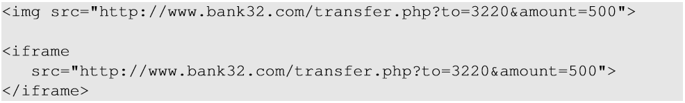
CSRF Attack on GET Requests - Basic Idea
The attacker can place the piece of code (to trigger request) in the form of Javascript code in the attacker’s web page.
HTML tags like img and iframe can trigger GET requests to the URL specified in src attribute. Response for this request will be an image/webpage.

Slide 92
Fundamental Causes of CSRF
The server cannot distinguish whether a request is cross-site or same-site
Same-site request: coming from the server’s own page. Trusted.
Cross-site request: coming from other site’s pages. Not Trusted.
We cannot treat these two types of requests the same.
Does the browser know the difference?
Of course. The browser knows from which page a request is generated.
Can browser help?
How to help server?

Slide 93




CSRF Defenses
Secret Validation Token
Referer Validation
Custom HTTP Header(same site cookie)
<input type=hidden value=23a3af01b>
Referer: http://www.facebook.com/home.php
X-Requested-By: XMLHttpRequest

Slide 94
Countermeasures: Referrer Header
HTTP header field identifying the address of the web page from where the request is generated.
A server can check whether the request is originated from its own pages or not.
This field reveals part of browsing history causing privacy concern and hence, this field is mostly removed from the header.
The server cannot use this unreliable source.

Slide 95
Countermeasures: Same-Site Cookies
A special type of cookie in browsers like Chrome and Opera, which provide a special attribute to cookies called SameSite.
This attribute is set by the servers and it tells the browsers whether a cookie should be attached to a cross-site request or not.
Cookies with this attribute are always sent along with same-site requests, but whether they are sent along with cross-site depends on the value of this attribute.
Values
Strict (Not sent along with cross-site requests)
Lax (Sent with cross-site requests)

Slide 96
Countermeasures: Secret Token
The server embeds a random secret value inside each web page.
When a request is initiated from this page, the secret value is included with the request.
The server checks this value to see whether a request is cross-site or not.
Pages from a different origin will not be able to access the secret value. This is guaranteed by browsers (the same origin policy)
The secret is randomly generated and is different for different users. So, there is no way for attackers to guess or find out this secret.

Slide 97
Elgg’s Countermeasure
Uses secret-token approach : _elgg_tc and _elgg_token.
The values are stored inside two JavaScript variables and also in all the forms where user action is required.
The two hidden parameters are added to the form so that when the form is submitted via an HTTP request, these two values are included in the request.
These two hidden values are generated by the server (views/default/input/securitytoken.php) and added as a hidden field in each page.

Slide 98
Login CSRF

Slide 99
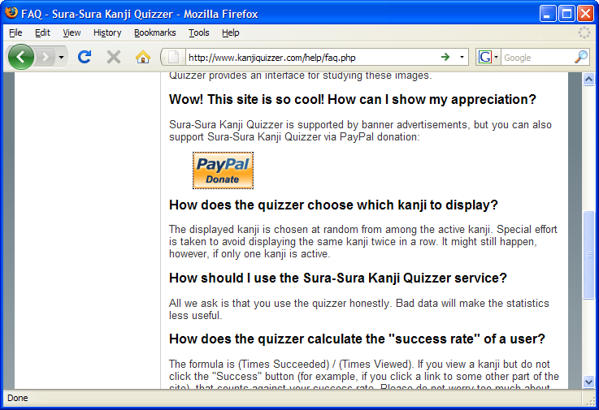
Payments Login CSRF

Slide 100
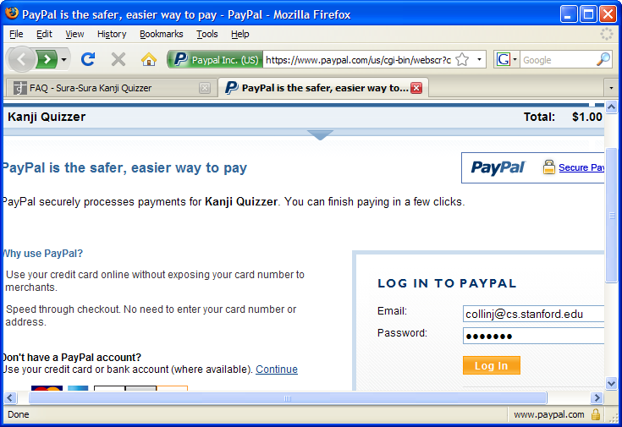
Payments Login CSRF

Slide 101
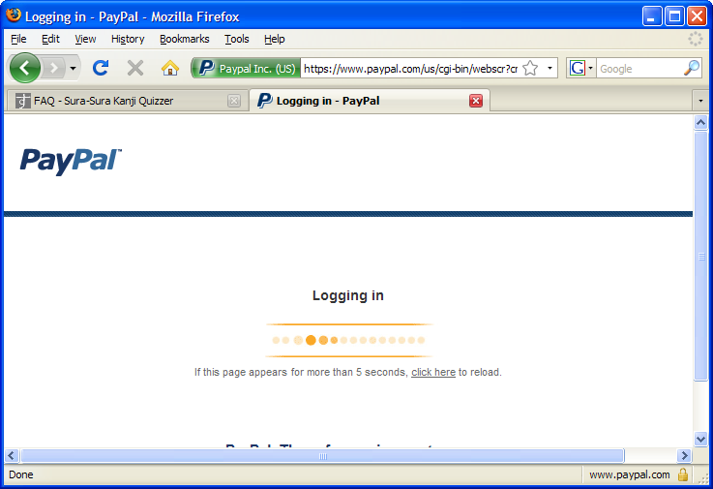
Payments Login CSRF

Slide 102
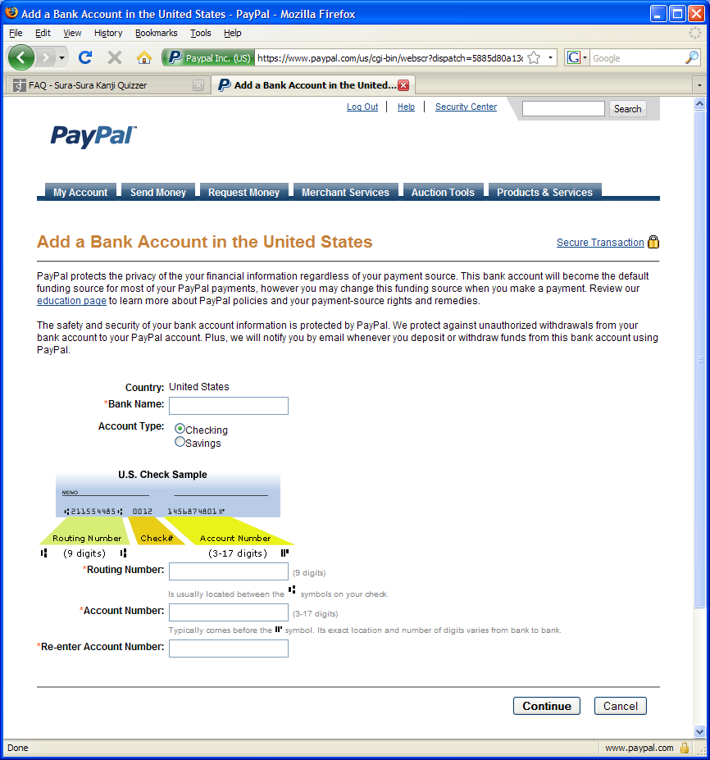
Payments Login CSRF

Slide 103
Login CSRF

